Slide 1
AWS Database
Add Partner logo

Slide 2
Unprecedented Data Growth Drives Innovation
Explosion of data
Micro-services changes data and analytics requirements
Rapid rate of change
Dev
Ops
Data grows 10x every 5 years
Purpose-built databases provide optimized performance and cost savings
Transition from IT to DevOps increases rate of change
Notes:
Before we can talk about how to take advantage of data, let’s first talk about three major trends that impact the way you think about data.
There are three trends : 1/there is an explosion of relevant data you could track; 2/micro-services changes data and analytics requirements; and 3/the DevOps model drives a rapid rate of change.
1/ Explosion of data
There is an explosion of data being generated. You have to track a lot of data that comes from your business applications. However, the growth is coming from data generated by network-connected smart devices that drive variety and volume of data. Every “smart” device produces real-time data, such as mobile phones, connected cars, smart homes, wearable technologies, home appliances, security systems, industrial equipment, machinery, and electronics. Most new cars have built-in cellular connections, which account for one third of mobile sign-ups on cell phone networks. Applications also generate real-time data such as purchase data from e-commerce sites, user behavior from mobile apps, and tweets/posts from social media.
By our estimates, data grows 10x every 5 years. To take advantage of all of this data, you need to be able to partner with someone who can easily harness this volume of data.
2/ Micro-services changes data and analytics requirements
Organizations are moving from development of monolithic applications to a micro-services architecture. Micro-services lets organization break down a complex problem into independent units so developers can operate in small groups with less coordination and therefore respond more quickly and go faster. However, there are 2 implications: 1/it means developers can break down apps into smaller pieces and pick the best tool to solve each problem; and 2/it increases the need for real-time monitoring and analytics to understand what’s not working between all of the different micro-services, faster.
Developers can break down their applications into smaller pieces and are not beholden to using a single database for every workload. Instead, they can pick the right database purpose-built for the job.
Analytics is not an after the fact activity; it has to be built-in to everything that you do. You need to know what’s going on in your businesses in real-time. To fuel innovation, well run businesses now operate on data quickly (whether automatically or through human intervention).
3/ Rapid rate of change driven by DevOps
As we innovate quickly, and the velocity of IT changes, businesses are transforming IT to the DevOps model. This model uses automated development tool to enable continuous development, deployment, and improvement of software. It emphasizes communication, collaboration, and integration between software developers and IT operations. It also introduces a fast rate of change (and change management).
This means as you think about data and designing your data platform, you need to think about the rapid rate of change that occurs through the DevOps model.

Slide 3
Self managing databases and analytics services is complex,
time consuming, and expensive
Hardware & software installation, configuration, patching, backups
Performance and high availability issues
Capacity planning and scaling clusters for compute and storage
Security and compliance
Notes:
For customers running legacy database and analytics infrastructure on premises or self-managed in the cloud (on EC2), provisioning, operating, scaling, and managing databases, data lakes, search, and streaming services is tedious, time-consuming, and expensive. They have to worry about operational efficiency issues such as hardware & software installation, configuration, patching, and backups; performance & availability issues; scalability issues such as capacity planning and scaling clusters for compute and storage; and security & compliance issues. such as network isolation, encryption, and compliance programs such as PCI, HIPAA, FedRAMP, ISO, and SOC.
Customer want to spend time innovating and building new applications, and not managing infrastructure.

Slide 4
Fully Managed Services on AWS Automate undifferentiated heavy lifting
Self Managed
Fully Managed
Schema design
Schema design
Query construction
You
Query construction
Schema design
Query optimization
Automatic fail-over
Backup & recovery
Automatic fail-over
You
Isolation & security
Backup & recovery
Industry compliance
Isolation & security
Push-button scaling
Industry compliance
Automated patching
Push-button scaling
Advanced monitoring
Automated patching
Routine maintenance
Advanced monitoring
E-commerce
Media streaming
Social media
Online gaming
Shared economy
Built-in best practices
Routine maintenance
4
Built-in best practices
Notes:
With AWS services, you don’t need to worry about administration tasks such as server provisioning, patching, setup, configuration, backups, or recovery. AWS continuously monitors your clusters to keep your workloads up and running with self-healing storage and automated scaling, so that you can focus on higher value application development. You focus on high value application development tasks such as schema design, query construction & optimization leaving AWS to take care of operational tasks on your behalf.
You never have to over or under provision infrastructure to accommodate application growth, intermittent spikes, and performance requirements and incur fixed capital costs which include software licensing and support, hardware refresh, and resources to maintain hardware. AWS does it all for you so you can spend time innovating and building new applications, not managing infrastructure.

Slide 5
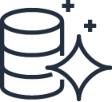
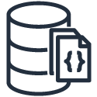
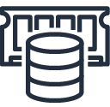
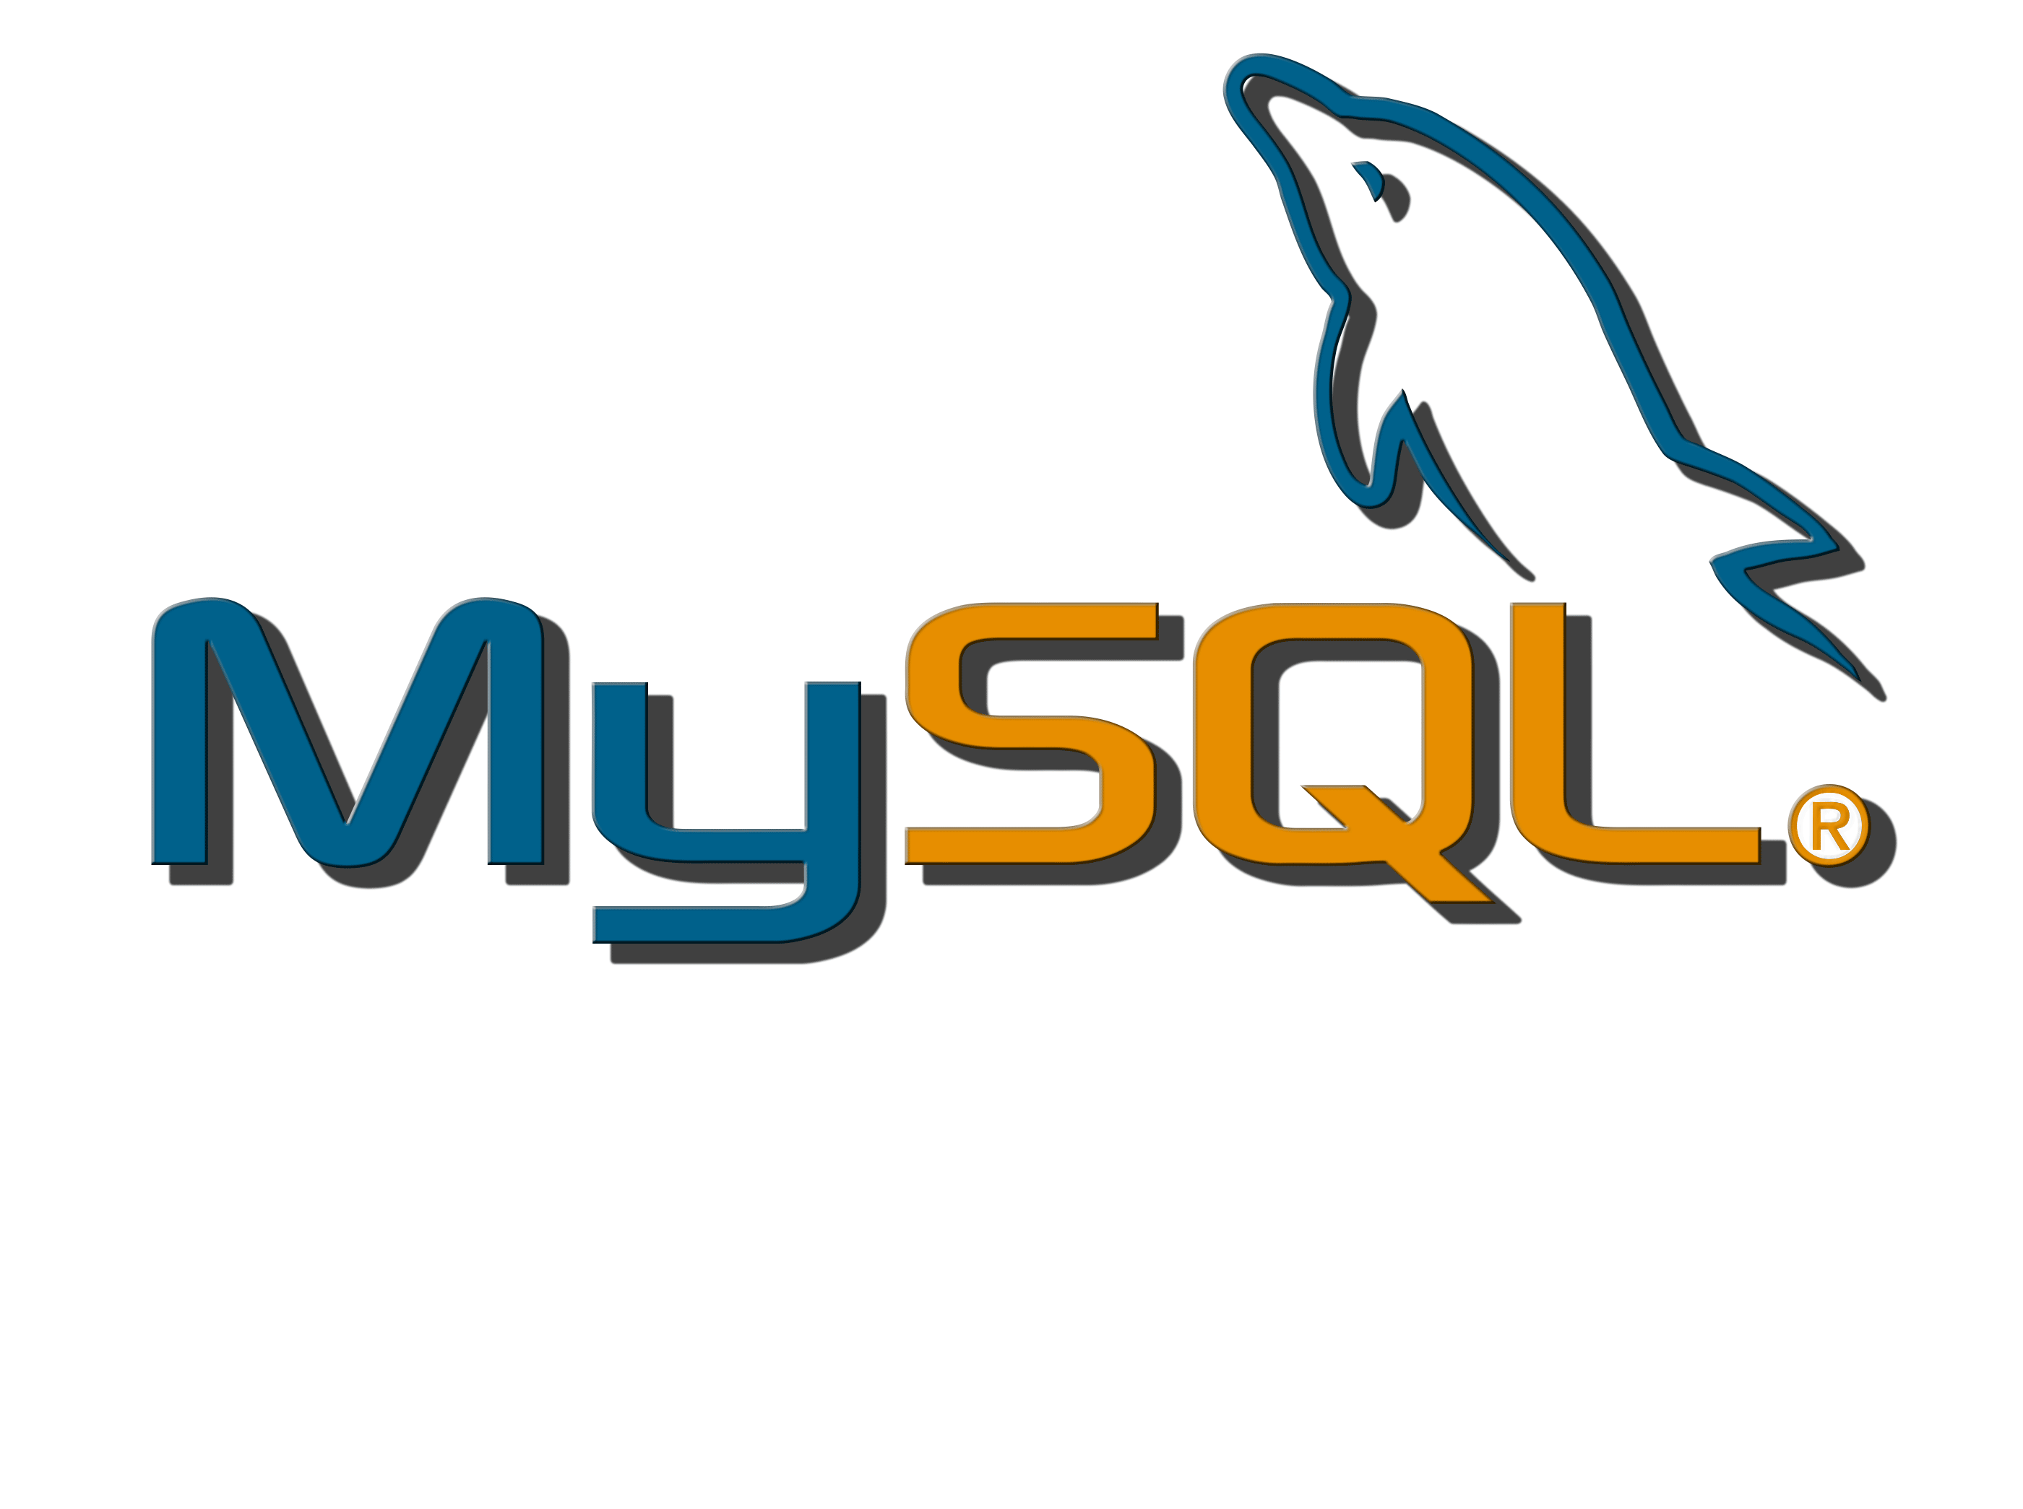
Move to Fully Managed Databases Migrate on-premises or self-managed databases to fully managed services
Amazon Aurora
Amazon RDS
Amazon DocumentDB
Amazon ElastiCache
Amazon Keyspaces
Relational databases
Non-relational databases
Notes:
The most straightforward and simple solution for many customers who are struggling to maintain their own relational databases at scale is a move to a managed database service, like Amazon RDS or Amazon Aurora. In most cases, these customers can migrate workloads and applications to a managed service without needing to rearchitect their application, and their teams can continue to leverage the same DB skill sets.
The target customer for a move from self-managed to managed relational DBs:
Is self-managing DBs on-premises, in EC2, and/or in another public cloud.
Would like to reduce DB admin burden and reallocate DBA resources to app-centric work.
Does not want to rearchitect their application. Wants to continue leveraging same skill sets.
Does need a simple path to a managed service in the cloud for DB workloads.
Wants better better performance, availability, scalability, and security
Customers can lift and shift their self-managed databases like Oracle, SQL Server, MySQL, PostgreSQL, and MariaDB to Amazon RDS.
For customers looking for better performance and availability, they can move their lift and shift their MySQL & PostgreSQL databases to Amazon Aurora and get 3-5X better throughput.
Customers use non-relational databases like MongoDB and Redis as document and in-memory databases for use cases such as content management, personalization, mobile apps, catalogs, and real-time use cases such as caching, gaming leaderboards, and session stores. The most straightforward and simple solution for many customers who are struggling to maintain their own non-relational databases at scale is a move to a managed database service, like 1/ Moving self-managed MongoDB databases to Amazon DocumentDB 2/ Moving self-managed in-memory databases like Redis & ElastiCache to Amazon ElastiCache. In most cases, these customers can migrate workloads and applications to a managed service without needing to rearchitect their application, and their teams can continue to leverage the same DB skill sets.
The target customer for a move from self-managed to managed non-relational DBs:
Is self-managing DBs on-premises, in EC2, and/or in another public cloud.
Would like to reduce DB admin burden and reallocate DBA resources to app-centric work.
Does not want to rearchitect their application. Wants to continue leveraging same skill sets.
Does need a simple path to a managed service in the cloud for DB workloads.
Wants better performance, availability, scalability, and security

Slide 6
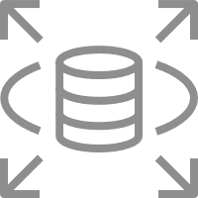
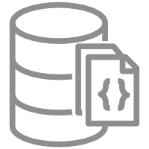
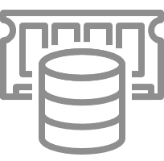
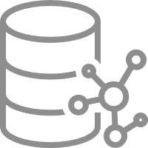
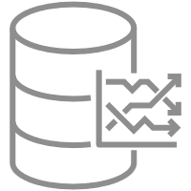
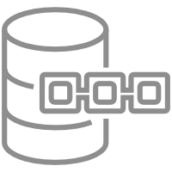
Purpose-built Databases
Aurora
RDS
DynamoDB
DocumentDB
ElastiCache
MemoryDB
Neptune
Timestream
QLDB
Keyspaces
Notes:
1/ Instead of looking at a list of hundreds of different databases, what if we instead think about common database categories. This is a simple mental model to help us reason how builders use these different systems.
2/ Relational is a category. Many builders understand relational systems, so I won’t spend a lot of time here - if you have a workload where strong consistency matters, where you will work with the team to define schemas, you’re not really sure every single question that will be asked of the data, but when you do, it matters that you always get back a consistent answer, then relational is a good fit. This is where Amazon Aurora fits, Amazon RDS open source engines (PostgreQL, MySQL, and MariaDB), and RDS commercial engines such as SQL Server and Oracle Database.
3/ To help with this change in how builders develop applications, over the years we have built a number of purpose-built non-relational database. Starting in the key-value category with Amazon DynamoDB, a database that optimizes running key-value pairs at single-digit millisecond latency and at very large scale. A DynamoDB table can have one item or a trillion items and it will perform the same. Many, many companies, like Epic with Fortnite and Lyft, use DynamoDB. And just to give you an example of the type of scale that DynamoDB supports, over the two days of Prime Day, our biggest retail event in the history of the company, DynamoDB requests from Alexa, the Amazon.com sites, and the Amazon fulfillment centers totaled 7.11 trillion, peaking at 45.4 million requests per second. And, that is only a fraction of the total capacity that DynamoDB handles on any given day. This is unusual scale.
4/ Or, in the document category, let’s say that your developers want a flexible way to store and query data in the database by using the same document-model they use in their application code. Some refer to this as a schema on read system. Take Intuit as an example. Their automated compliance platform (ACP) ensures all of Intuit’s AWS resources, across thousands of accounts, meet Intuit’s various compliance standards. ACP tracks audit events from tens of thousands of Intuit assets that are each modeled on a JSON document. As Intuit built the platform, they needed a database that can natively store, query, and index a diverse set of documents. That’s why we built Amazon DocumentDB, a fully managed, MongoDB-compatible document database that is purpose built to help developers easily work with JSON documents in their natural format but is also architected to scale easily to meet Intuit’s growing needs. I always pause her for a minute. Do you remember when XML was a thing? I think XML 1.0 was first established in 1998. Back then, what did commercial systems do to become an XML database? They added an XML data type. The problem is, many of the database operators didn’t work with that data type. I would argue what document databases are today is what I think people were trying to do with XML years ago. Amazon DocumentDB launched in January 2019 and it’s off to a great start. And that’s why companies like Intuit, FINRA, Dow Jones and thousands of others use it to store, retrieve, and manage JSON documents at scale.
5/ But let’s say your application can’t even stand single-digit millisecond latency. You need something even faster like microsecond latency. You would need to use an in-memory database and have a cache that can access data in microseconds. And that’s why we built Amazon ElastiCache, which is managed Redis and managed Memcached, and that’s what companies like Grab, McDonald’s, and Peloton use to enable fast retrieval of data for real-time processing use cases such as messaging and real-time geospatial data like drive distance. We also Amazon MemoryDB for Redis, a Redis-compatible, durable, in-memory database that delivers microsecond read and single-digit millisecond write latencies. MemoryDB enables ultra-fast performance like ElastiCache, but also offers durability by storing data using a Multi-AZ transactional log which offers fast database recovery and restart with no data loss. MemoryDB is especially useful for microservices applications for web and mobile apps, e-commerce, banking and finance, gaming, and media and entertainment.
6/ Let's say that you have datasets that are really large and have a lot of interconnectedness. Take Nike as an example. They built an app on top of AWS which connects their athletes with their followers and provides personalized recommendations based on interests of more than 100 million users. Those are a lot of connections if you think about all the athletes and all the followers and all the interests. And they need fast queries over all of that connectedness. For example, running a complex query to learn the top five interests of all the followers of a certain athlete is easy to do on a graph database but unwieldly and slow on a relational database. That's why people are excited about graph databases and why we built Amazon Neptune, which is what companies like NBC Universal, Netflix, and Uber use for highly connected datasets.
7/ Driven by the rise of IoT devices, IT systems, and smart industrial machines, time-series data — data that measures how things change over time — is one of the fastest growing data types. Time-series data has specific characteristics such as typically arriving in time order form, data is append-only, and queries are always over a time interval. Time-series data is not just a timestamp or a datatype that you might use in a relational database. Instead, what makes a time-series database is that at its core, the single primary axis of the data model is time. Which means you can highly optimize how the data is stored, scaled, and retrieved. For this we have Amazon Timestream, a purpose-built time-series database that is in preview today.
8/ Ledgers are typically used to record a history of economic and financial activity in an organization. Many organizations build applications with ledger-like functionality because they want to maintain an accurate history of their application’s data, for example, tracking the history of credits and debits in banking transactions, verifying the data lineage of an insurance claim, or tracing movement of an item in a supply chain network. For this we built Amazon QLDB, a fully managed ledger database that provides a transparent, immutable, and cryptographically verifiable transaction log. BMW uses QLDB for their Digital Vehicle Passport Application, which maintains the complete and verifiable history of a vehicle, including maintenance records, tire changes, accidents, ownership, insurance, and loan records. This application will act as the single trusted authority where multiple third-party entities such as car dealerships, repair shops, banks, and insurance providers will submit data to BMW
9/ For applications that require high speed data processing with single-digit-millisecond latency, such as industrial equipment maintenance, trade monitoring, fleet management, and route optimization, a wide-column database is a great choice. We have a wide-column option in Amazon Keyspaces for Apache Cassandra, a scalable, highly available, and managed Apache Cassandra–compatible database service. Amazon Keyspaces is serverless, so you pay for only the resources you use and the service automatically scales tables up and down in response to application traffic. You can build applications that serve thousands of requests per second with virtually unlimited throughput and storage.
10/ People want the right tool for the right job, and they want the right database for whatever their workload is.

Slide 7
For more information contact our team: xxx xxx xxx
Add Partner logo

